Slide 1

COVID-19 Exploratory Data Analysis
Global and Regional Trends (2020–2024)
Presented by: Mayur
Date: 17-09-2025

Slide 2
Introduction
objective :-
The objective of a COVID-19 analysis is to study the trends of cases, deaths, and recoveries to understand the pandemic’s impact globally and regionally.
Data sources :- Our World in Data COVID-19 dataset
time span :- 2020-01-05 To 2024-08-04
Features used: location,continent, date, total_cases, new_cases, total_deaths, new_deaths, population

Slide 3
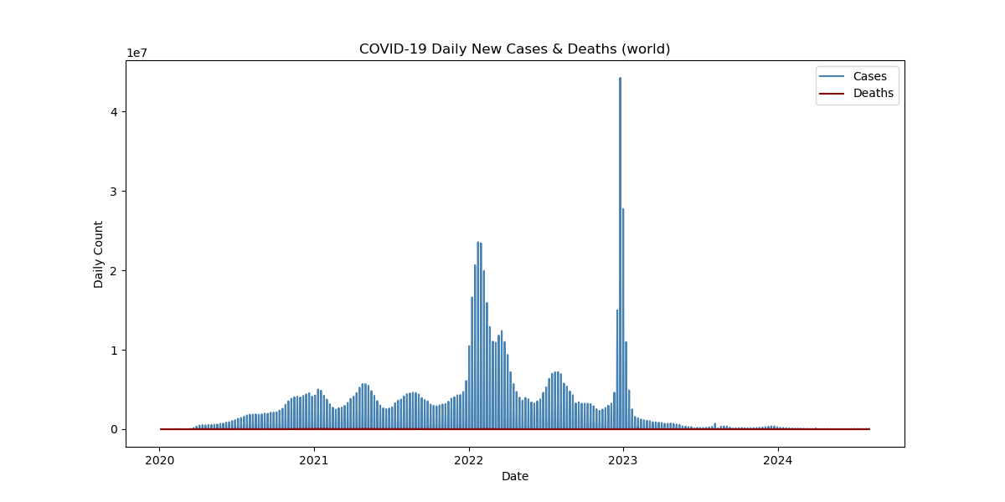
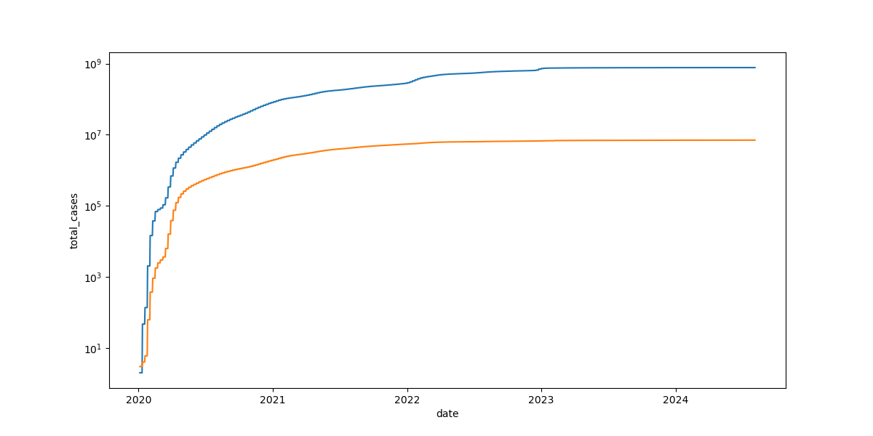
Global Overview
Insight : COVID-19 spread rapidly with multiple global waves, peaking in early 2023.Deaths did not increase proportionally with cases in later stages, showing the pandemic became less deadly over time (due to immunity, vaccines, and treatments).By 2024, both new cases and deaths were very low, indicating the pandemic had largely subsided globally.

Slide 4
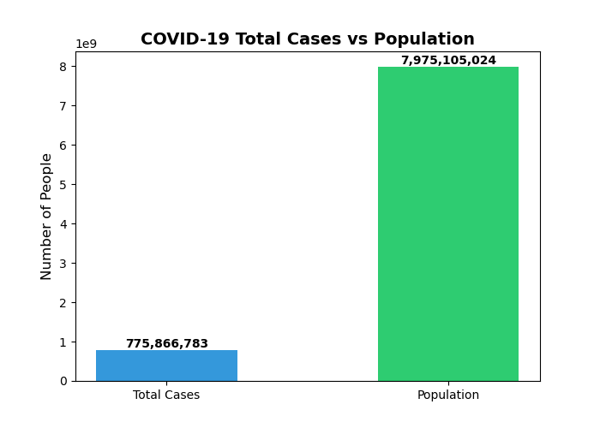
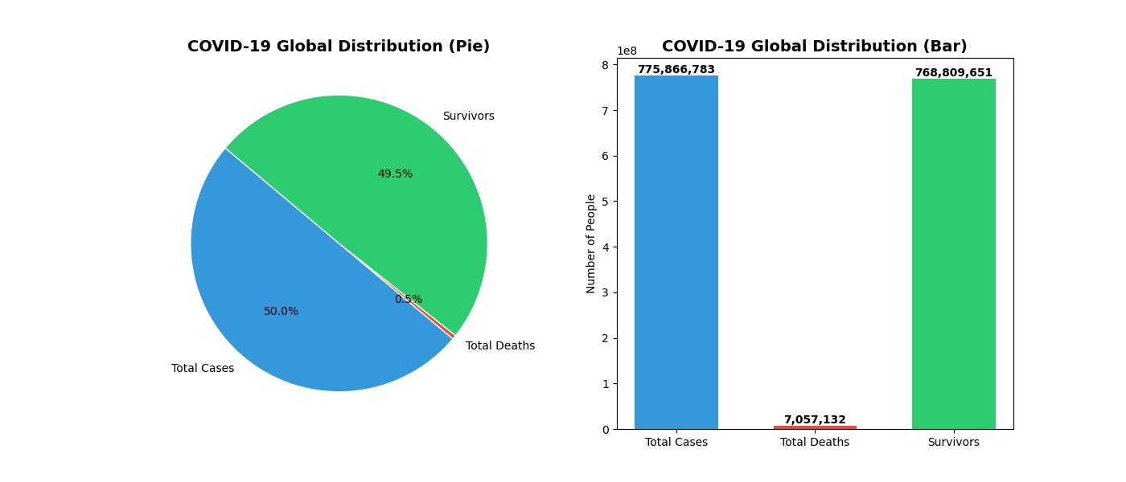
Cases vs Population(World)
Insight :
Scale of pandemic: Almost 776 million confirmed cases, but still under 10% of the world’s population officially recorded.
Survival rate: Extremely high — 99%+ of reported cases survived, thanks to immunity, vaccines, and improved treatments.
Mortality: Less than 1% fatality rate globally, though higher in vulnerable populations.
Perspective: While the pandemic was devastating in terms of deaths and social/economic disruption, the sheer number of recoveries highlights human resilience and medical progress.

Slide 5
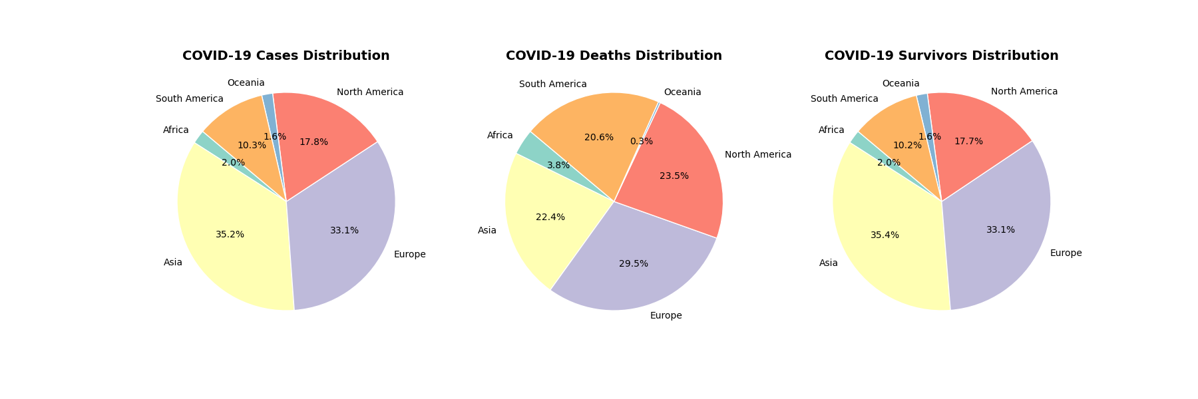
Continental Distribution
Insight :
Asia & Europe → Highest number of cases and survivors.
South America → Disproportionately high death share compared to cases, meaning higher case fatality rates.
North America → High in both cases and deaths, but lower than Asia/Europe in proportion .
Africa & Oceania → Very low share of cases and deaths globally (likely due to lower testing/reporting or genuinely lower spread).
Global lesson: Regional health infrastructure, vaccination speed, and population demographics had a major impact on survival and death rates.

Slide 6
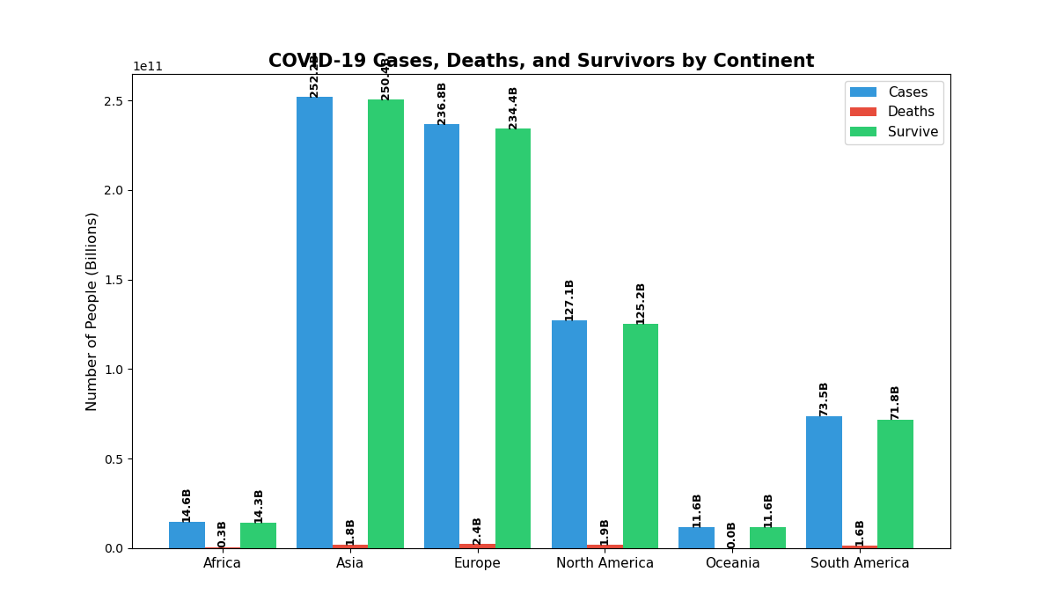
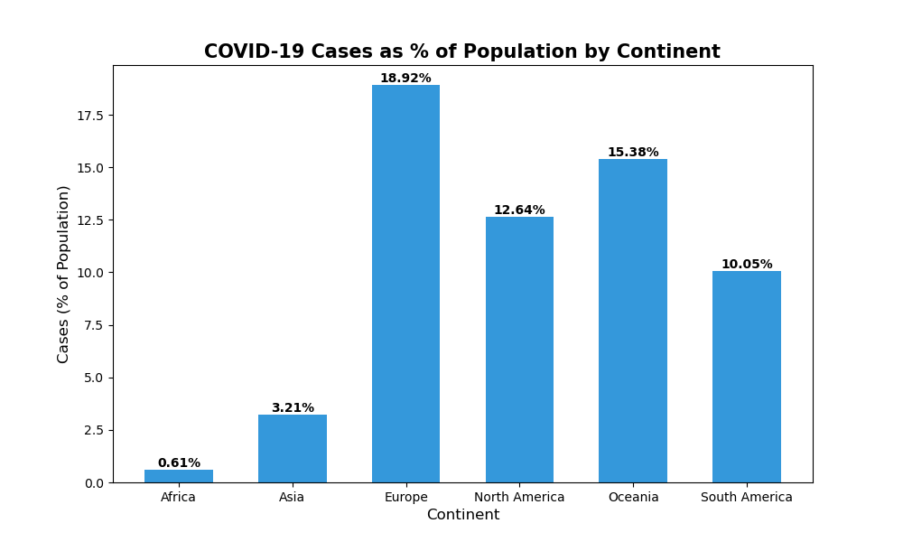
Cases, Deaths, Survivors by Continent and cases by population
Insight :
Europe and Oceania were hit hardest proportionally, with the highest infection rates per population .
Asia had the highest absolute number of cases, but because of its very large population, its percentage of infected people was relatively low.
Africa had both the lowest absolute and relative number of cases, suggesting lower transmission, underreporting, or different demographic factors.
Survival was overwhelmingly high across all continents, meaning the death rate was consistently a small fraction of total cases.

Slide 7
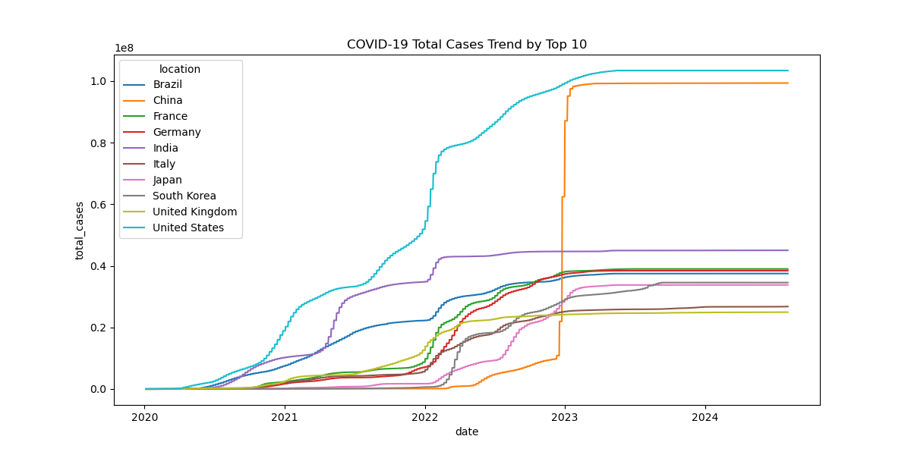
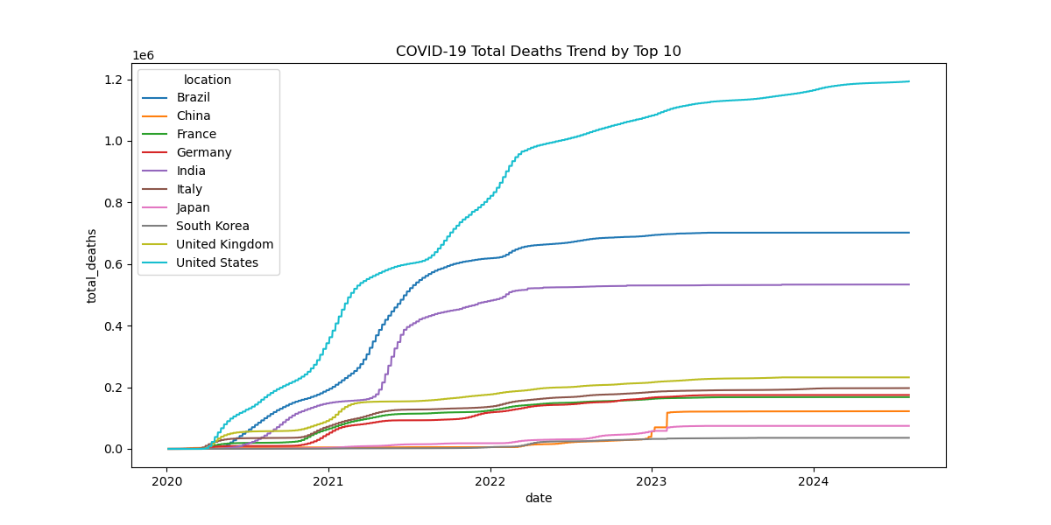
Top 10 Countries – Total Cases and Total Deaths
Insight :
United States had the highest global burden in both cases and deaths, showing the largest pandemic impact.
China’s data shows anomalies: cases surged dramatically in 2023 but deaths did not match, possibly due to reporting practices.
India and Brazil suffered massive death tolls during early pandemic waves (Delta variant).Europe (UK, France, Germany, Italy) saw heavy waves early, but later stabilized.
Japan and South Korea highlight a contrasting story: very high late-stage case counts but comparatively low deaths → suggesting better healthcare outcomes or demographic advantages.

Slide 8
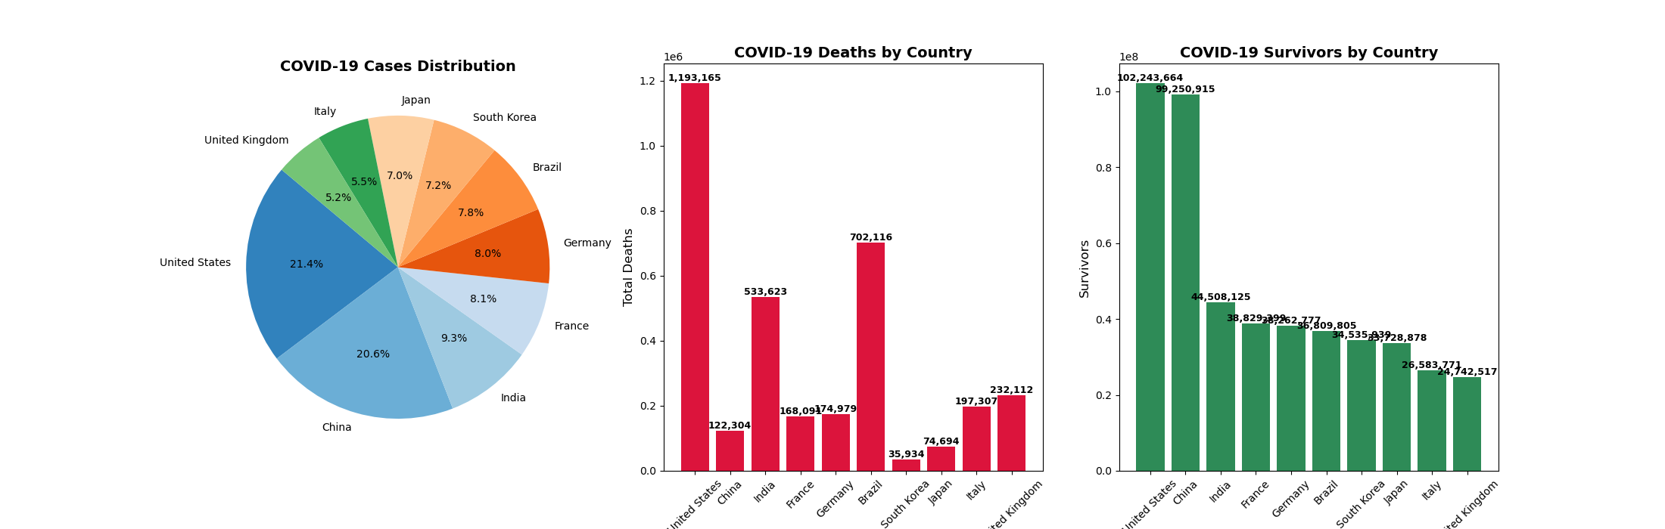
Country-Level Breakdown
Insight :
Case Burden: The pandemic was most concentrated in the United States, China, and India.
Deaths: The United States, Brazil, and India suffered the heaviest death tolls.
Survival Rates: Despite massive case loads, survival was overwhelmingly high in all countries, but East Asian countries (Japan, South Korea, China) stand out for having low death-to-case ratios.

Slide 9
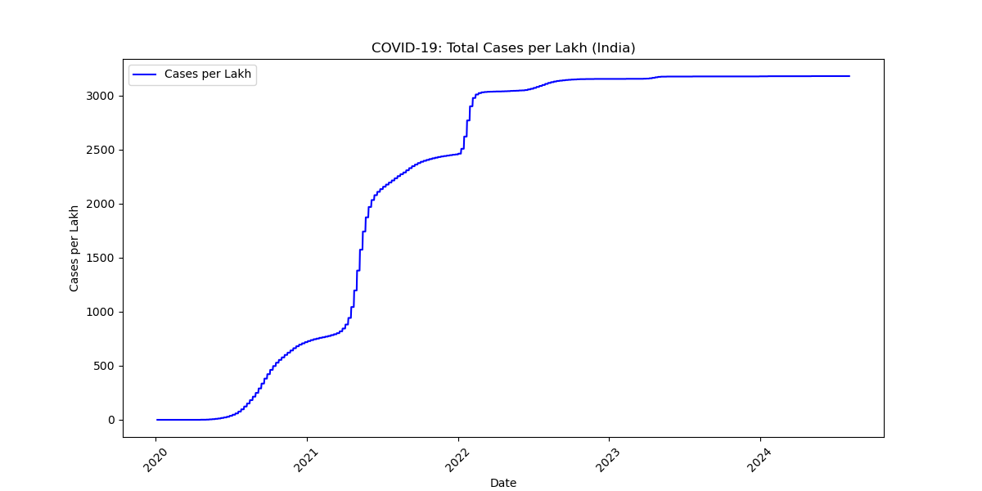
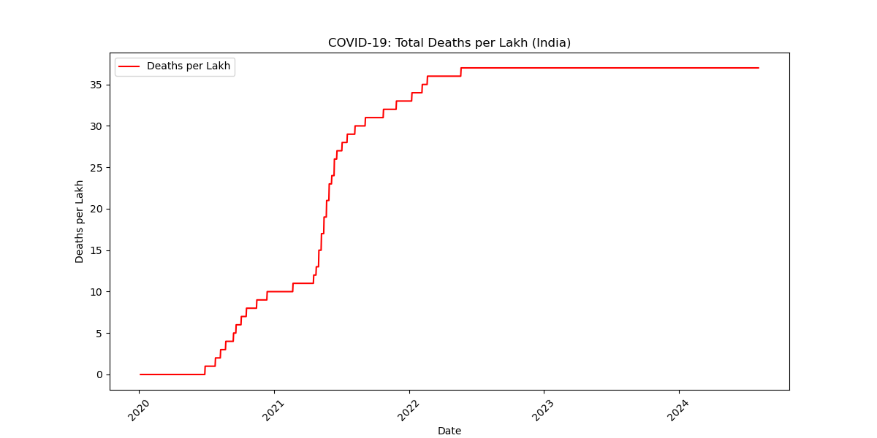
India Trend Analysis
Insight :
Cases surged in 2021 and 2022, peaking at ~3200 per lakh, but slowed down afterward.
Deaths were concentrated in the Delta wave (2021), reaching ~37 per lakh, and did not rise much after.

Slide 10
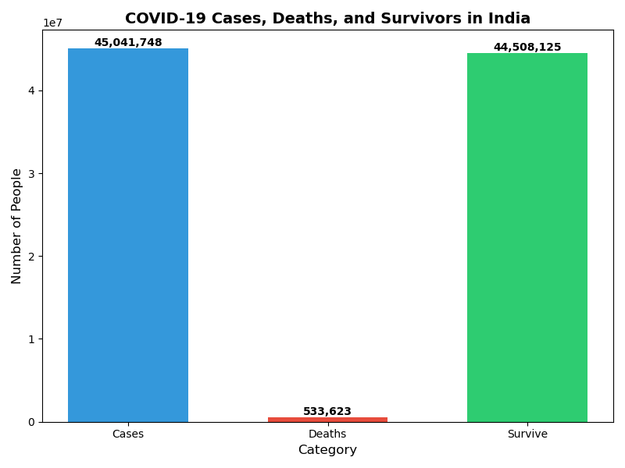
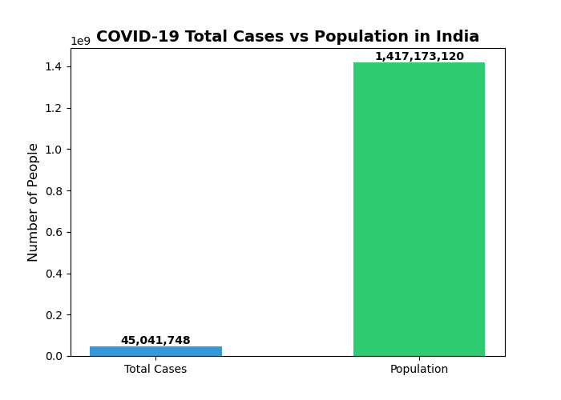
India Cases , Deaths & Survive
Insight: The impact of COVID-19 in India was severe in absolute numbers, but relative to the huge population, the proportion infected was small (~3%).
The recovery rate was very high (~99%), with deaths making up just over 1% of total cases.

Slide 11
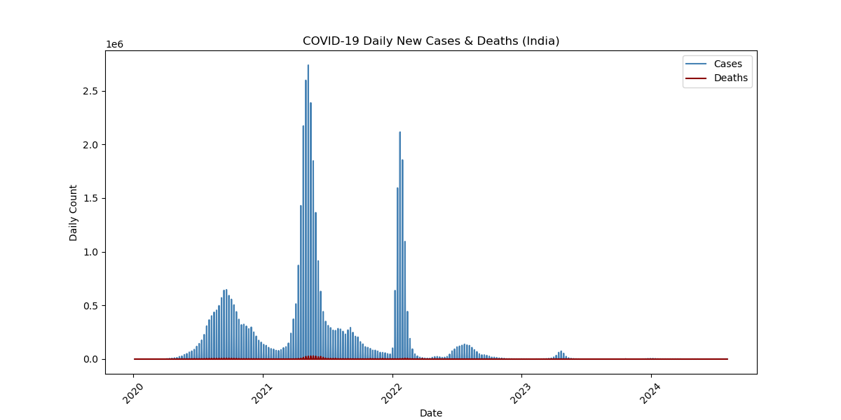
India Daily New Cases & Deaths

Slide 12
Deaths Per Lakh in World

Slide 13
Key Insights & Takeaways
Global recovery rate is high
Disparities in death rates across regions
India’s pandemic curve stabilized post-2022
Policy and healthcare infrastructure played a major role

Slide 14
Thank You
Q&A prompt

